Slide 1
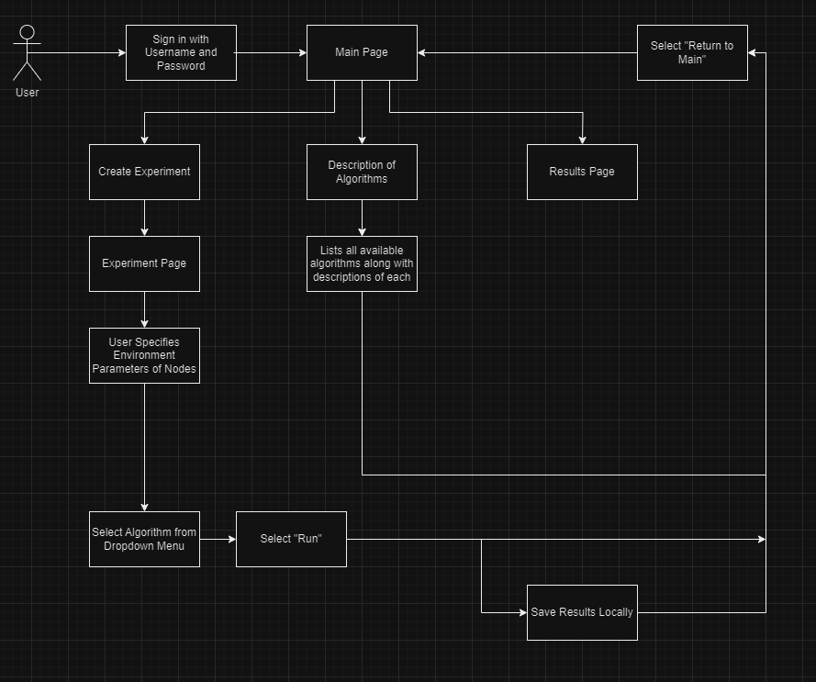
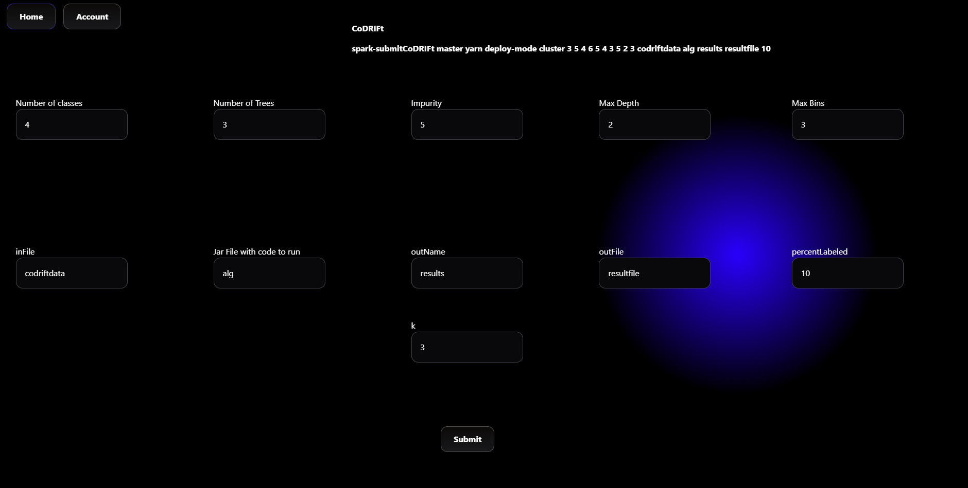
The PICARD
Abdalrahman Afifi, Hunter Lavender, Travis Mueller, Zachary Wildasin, Dr Thomas Devine
What is PICARD?
Highlight of Technologies
Functional Requirements
Hardware
Platform for Intelligent Computer Algorithm Research and Development
Dedicated for the research, development, and performance analysis of algorithms
Mainly focusing on classification of large data sets
Graphical User Interface (GUI) providing an intuitive interface to adjust parameters
Utilization of Firebase cloud
Graphical User Interface is created with ReactJS,bootstrap, and universe.io
Docker & Docker Swarm
Distributing Computing
Create the fullstack for the PICARD
Have user authentication using two factor authentication
Make sure the website is using the HTTPS protocol for security
Be able to create jobs through a UI instead of command line
Server:
Linux Based Server
2 Intel Xeon gold 5218 processors
Docker
Nodes:
Ubuntu based linux operating system
Apache Spark for distributed data
processing
Acomplishments
Conclusion and Future Work
Functional user interface
UI implemented with ability to construct parameters for experiments
Ability to install application on additional hardware through containers
Create scalable systems that grant future researchers flexibility when using the PICARD
Review extensive documentation from previous semesters
Have contingency plans in place and be adaptable
Use output from UI to run algorithms
Focus on adding data visualizations from results
6 December 2023 West Virginia University Engineering Expo
Notes:
Click new slide in the menu bar then select template of choice for title slide and title/text slide formats. You can choose from various colors and textured backgrounds. Displayed is suggested font size and color.

